Slide 1
Project demo
Jialong Li

Slide 2
Technology Survey I - Frontend
In my final implementation, I choose to use HTML, CSS and JavaScript as my frontend technology, which is the same as my phase one planning. However, there is one change that I integrated them into jsp files.
Jsp is java server pages, which is a server-side programming technology that enables the creation of dynamic, platform-independent method for building Web-based applications. It can access the whole family of Java APIs. I can write JSPs as text files that combine HTML codes and XML elements etc.
For the database technology, I choose to use MySQL. This technology is the same as what I wrote in Phase I, but as I implementing the project, I find that there are more advantages to choose MySQL as my database technology.

Slide 3
Technology Survey II – DB and backend
First of all, in this project we are trying to design a book ordering system. If we use a non-relational database management system like NoSQL, its key-value pairs are not suitable since in this project we need to define the schemas in advance.
Moreover, our constraints over functionalities are strict. For instance, in ordering functionality, we need to make sure the specific book can only be ordered once, which is part of the ACID principle. The the last book was ordered twice in ordering system, it would cause real problems onto the customers.
For the backend programming language, I chose Java, which is the same as the Phase I. However, this time I chose to use Servlet Framework instead of the Spring. The servlet is simpler to implement than the Spring framework. I can call numerous simple APIs to make my implementations easier like connecting to the port or the database.

Slide 4
Technology Survey III – Useful Tools
To visualize my database table settings, I used a tool called Navicat. This tool provides me a graph interface that makes me easy to add records or modify tables. For instance, when I find a mismatch between my backend SQL queries and the database tables on fields, I can directly rename the fields and solve the bug. Moreover, since it can visualize the structure of the tables and the fields, I can easily import outside records via Navicat interface by modifying and renaming the fields or the tables.
I used Tomcat to setup my local server so that I can access the pages directly from Chrome. In fact, the tomcat is a container for a Java Servlet, and it is able to receive requests from a client, dynamically compile and handle the request, and return the result to the client. I used the Tomcat to interact between the client and the server.

Slide 5
I learned what?
From this project, I learned about how to design a huge system and coding its implementation. In the past, I had not yet touched the knowledge of the frontend programming. I just heard the nouns of HTMLs or the JavaScript before I started this project. Moreover, for the backend coding, I had not tried to build a server myself.
However, after implementing this final project, I figured out how the network connects the server and the local host, and how the database was implemented in a actual project. Designing icons and coding its functionalities costed me much time but it was worth when I finally saw the system ran. I feel I was so naïve when I wrote the design planning of this system. There are much more differences between the theory part and the implementation part. This project pushed me to learn much useful knowledge.

Slide 6
What difficulties I met?
Numerous bugs.
Since I used many new APIs I had never used before, this introduced lots of bugs and wrong uses. For instance, when I tried to design a frontend page, I planed to create a drop down list, but the list cannot display the right variable names I wanted. I debugged for a long time and finally I find the cause of the bug - there are some issues on my implementation of transferring values between the client and server. I looked up the error message, googled online, and read the Stack Overflow, finally located the part I coded wrong and fixed that.
The big picture of the system implementation.
I used to have trouble implementing the requirements. I tried to solve them one by one but I failed since some of the requirements are correlated between each other. I finally figured out how to implement the big system step by step after reading a blog written by the author who has worked as a product manager in a high-tech. His blog inspired me to draw a flow-chart of the requirements and structured it systematically.

Slide 7
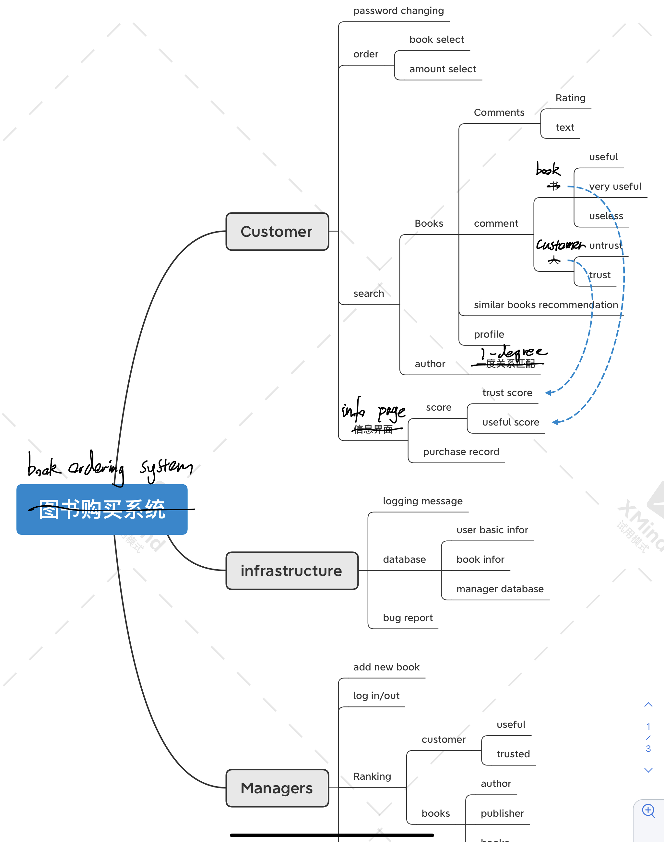
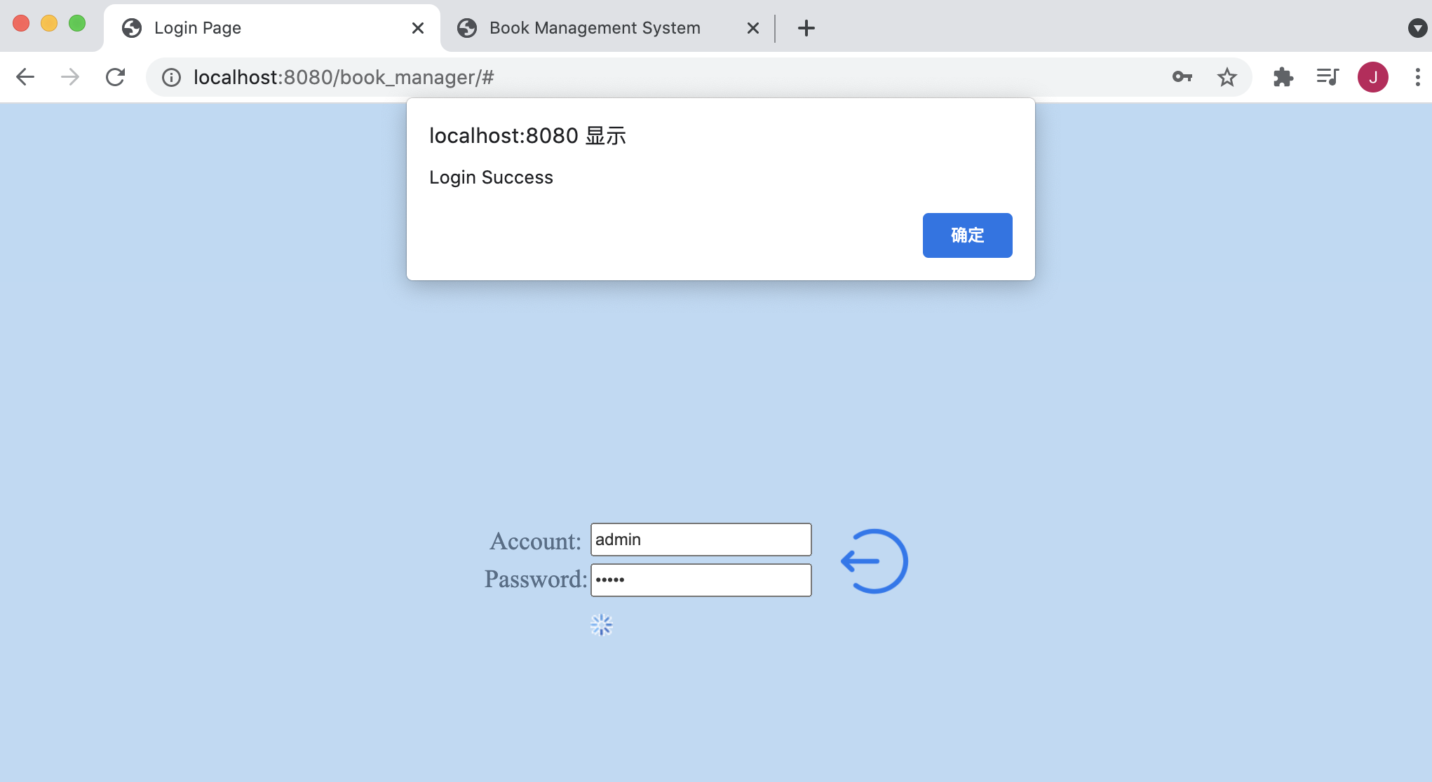
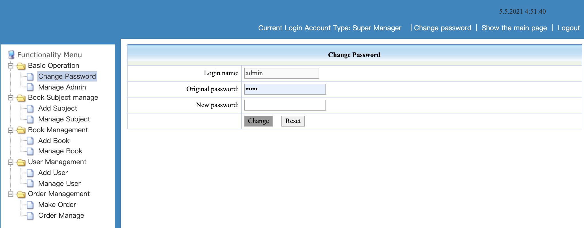
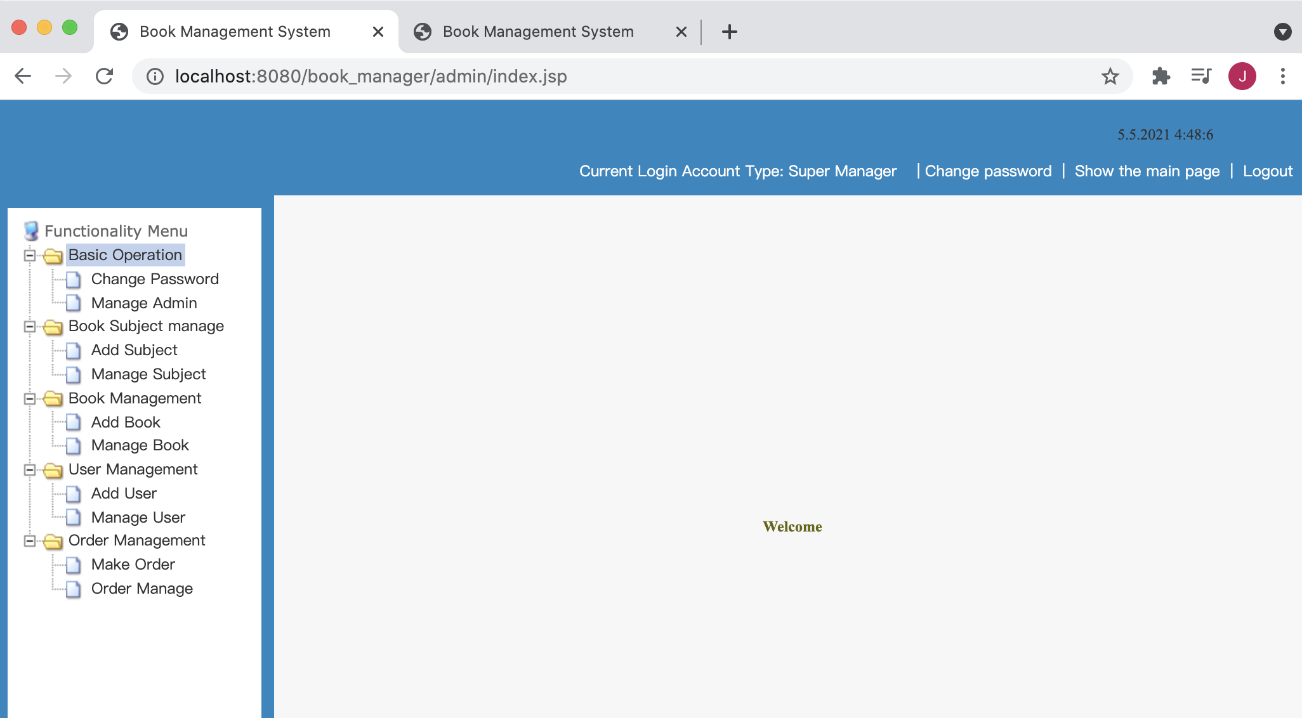
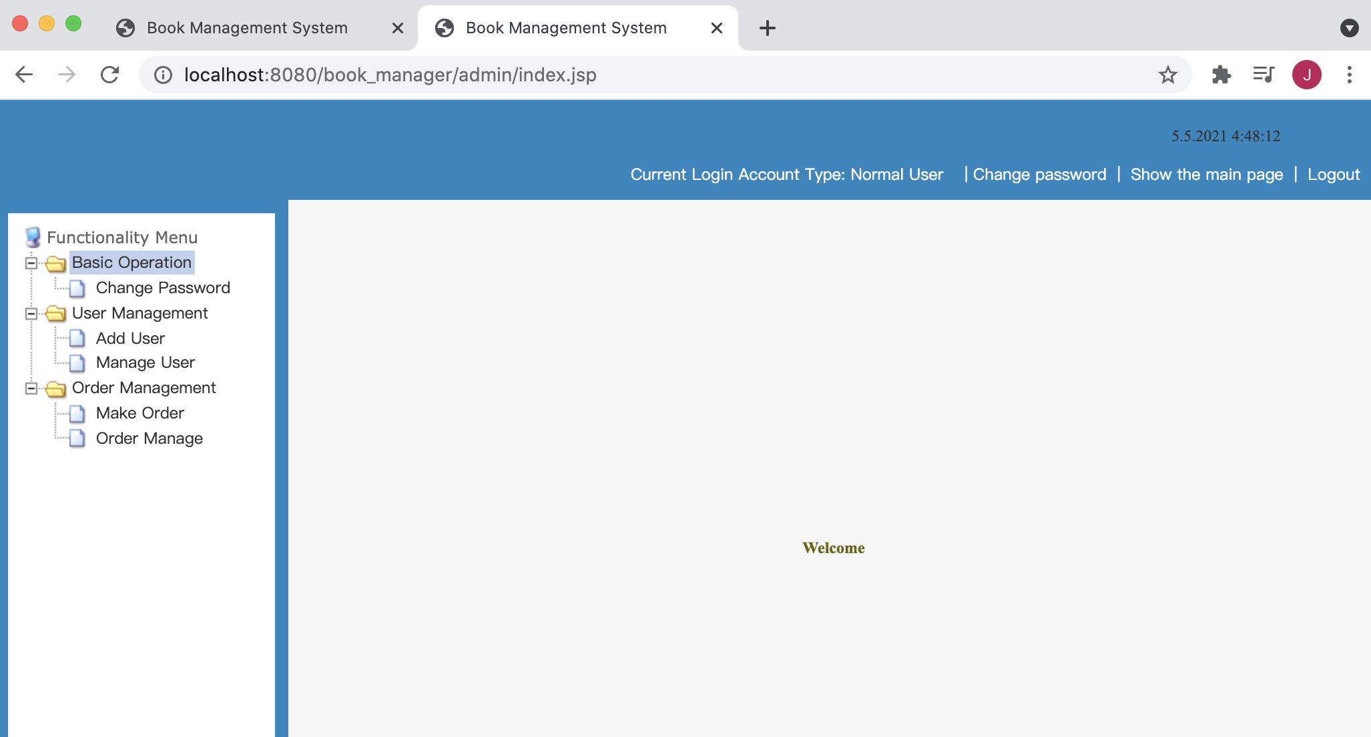
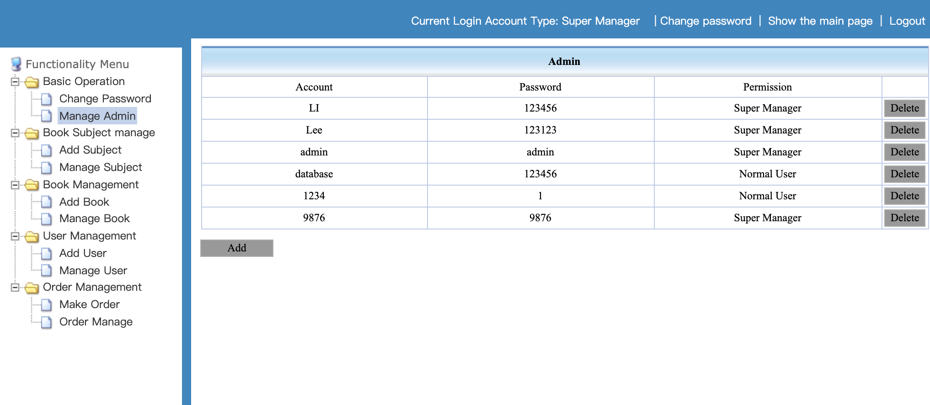
Part of screenshots of functionalities
The flow-chart before implementing
Login and concurrent login with different user mode
If just logged in, the original pw filed was prefilled.
Manager or the customer can directly change their pw
Manage Managers

Slide 8
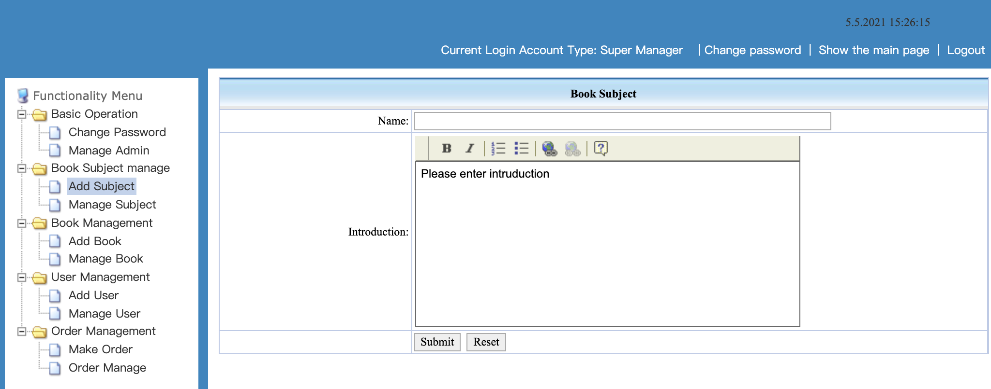
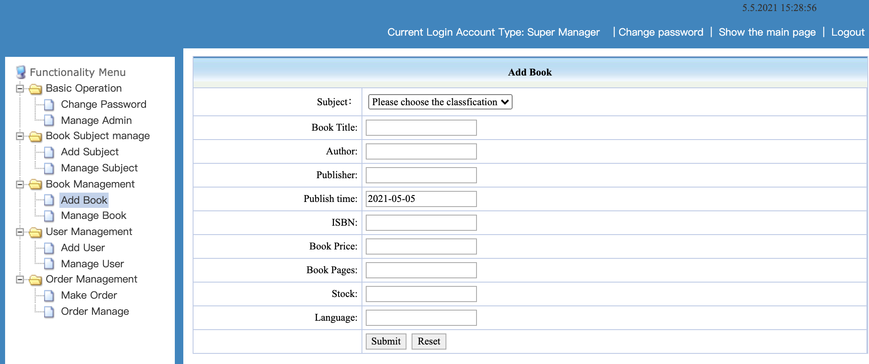
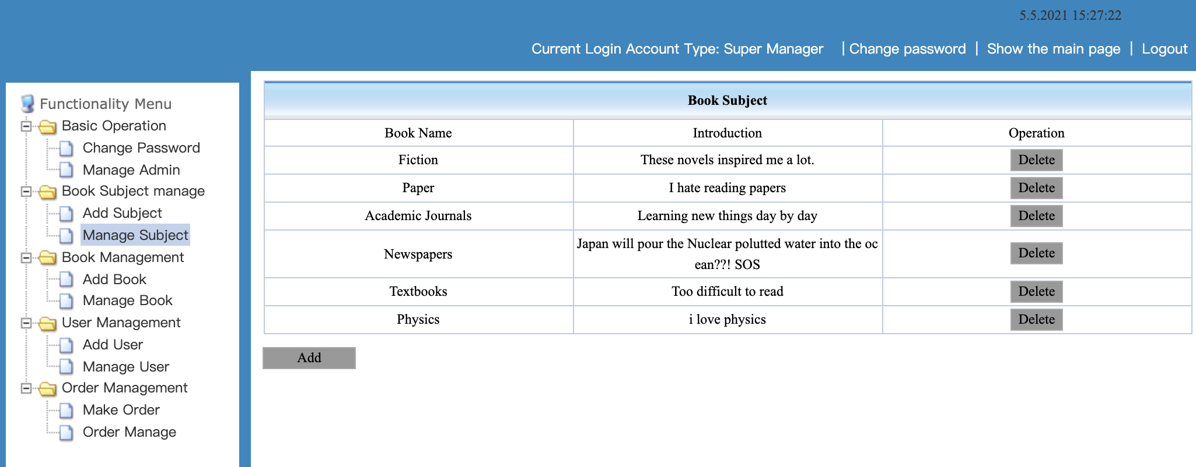
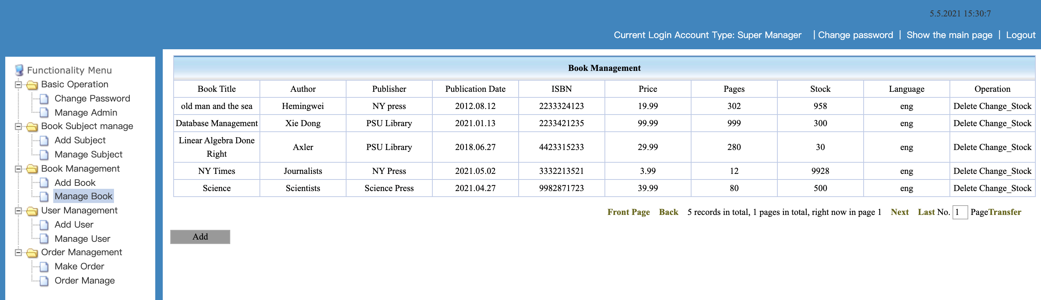
Part of screenshots of functionalities
Add Subject
Add Book
Manage Subject
Manage Book

Slide 9
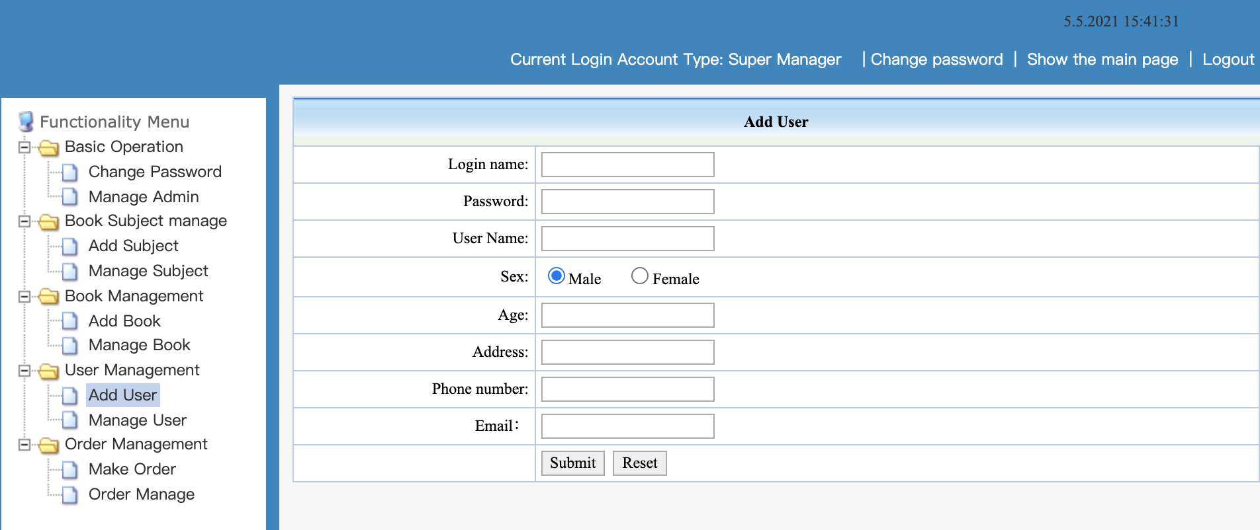
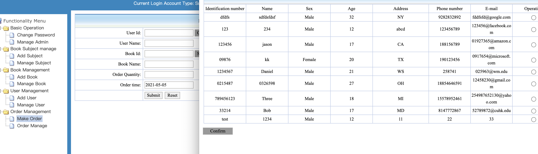
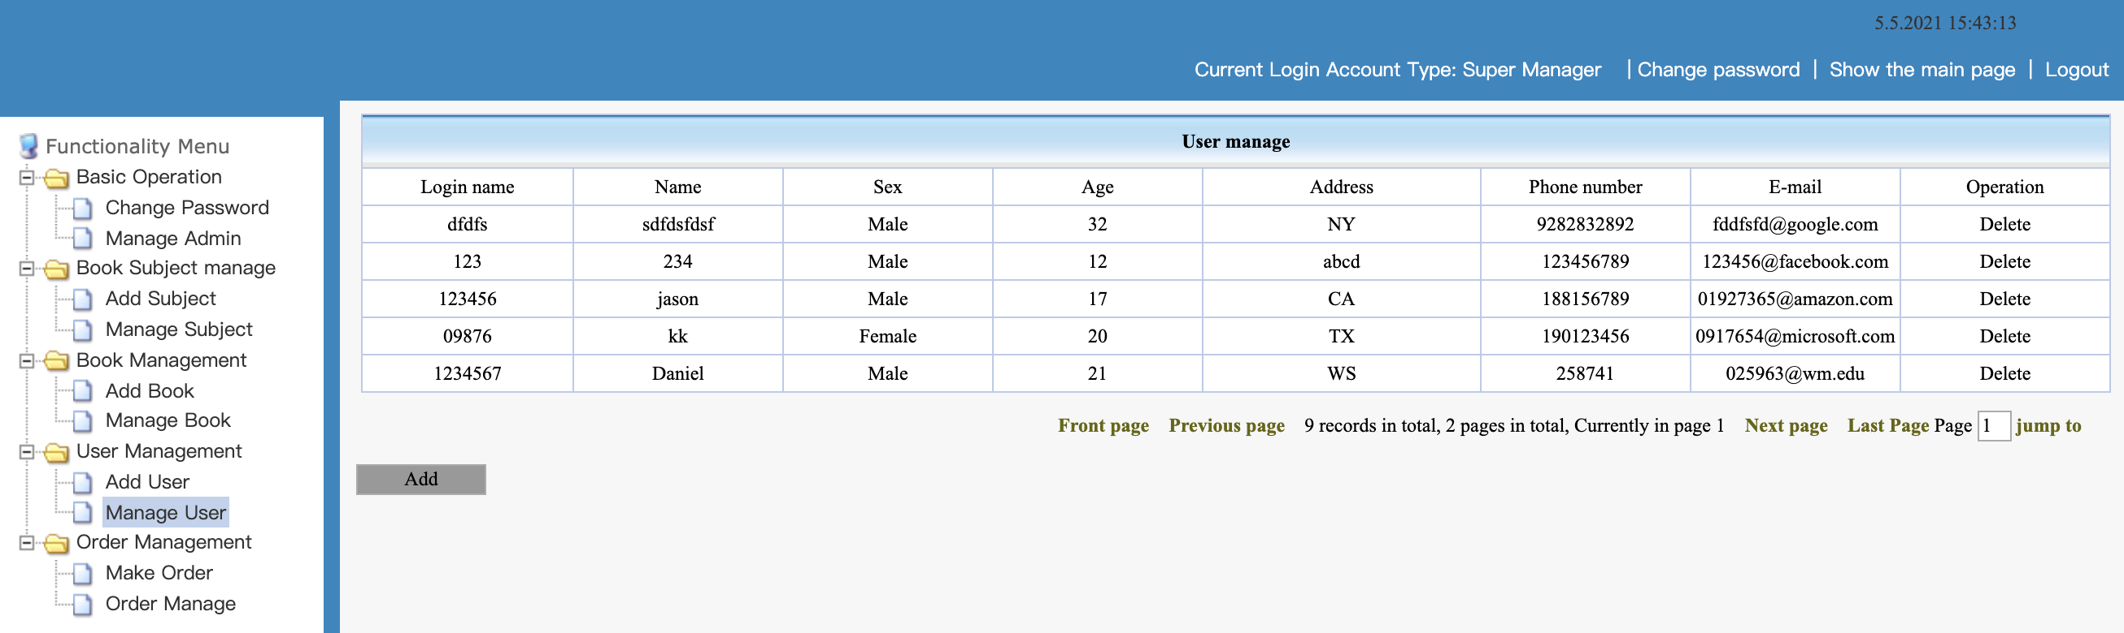
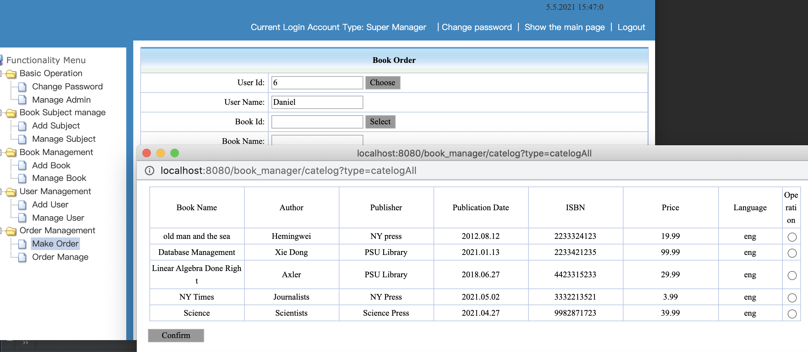
Part of screenshots of functionalities
Add User
Make Order when choosing customer
Manage User
Make Order when selecting book

Slide 10
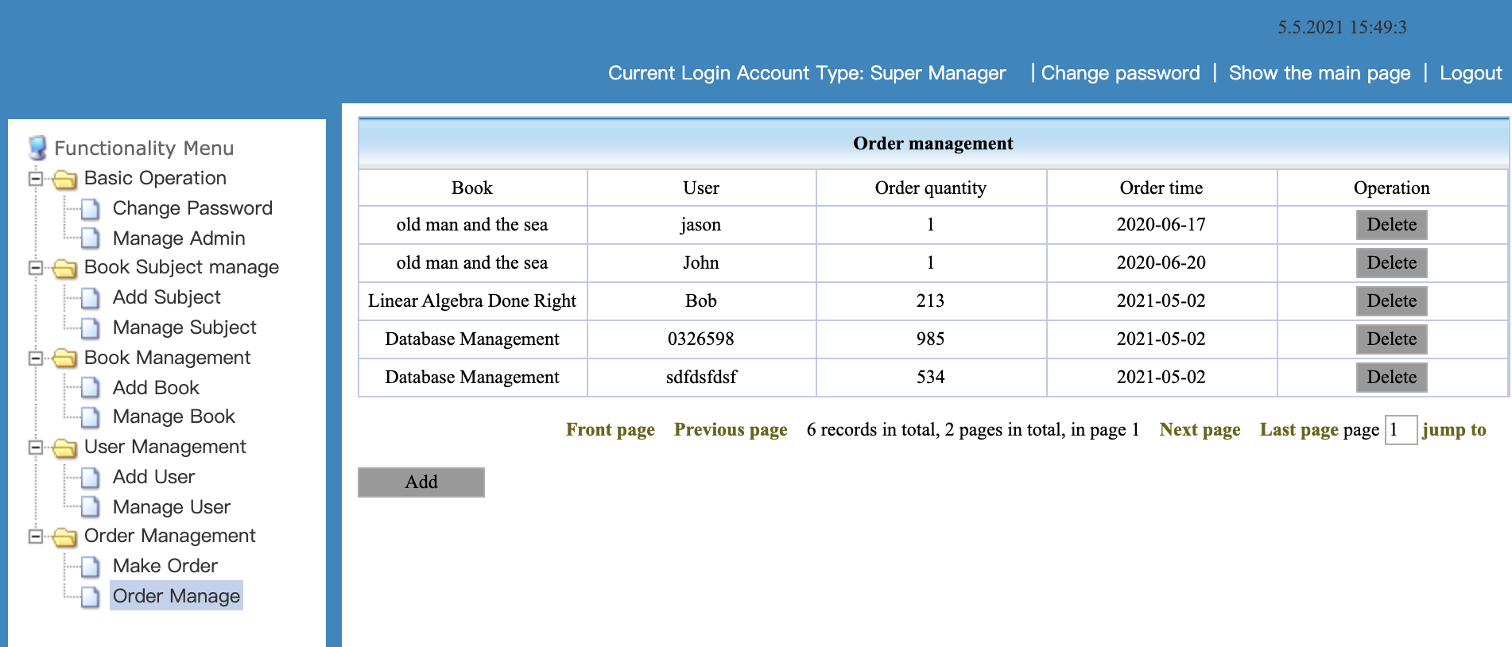
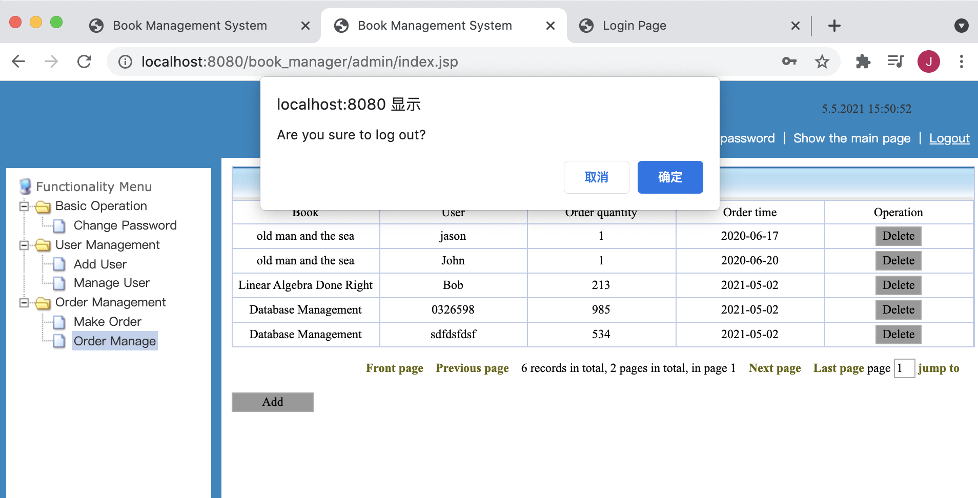
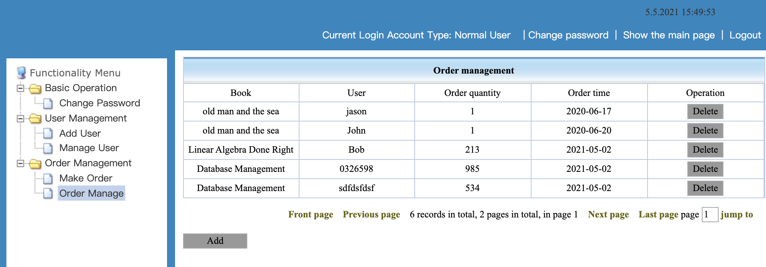
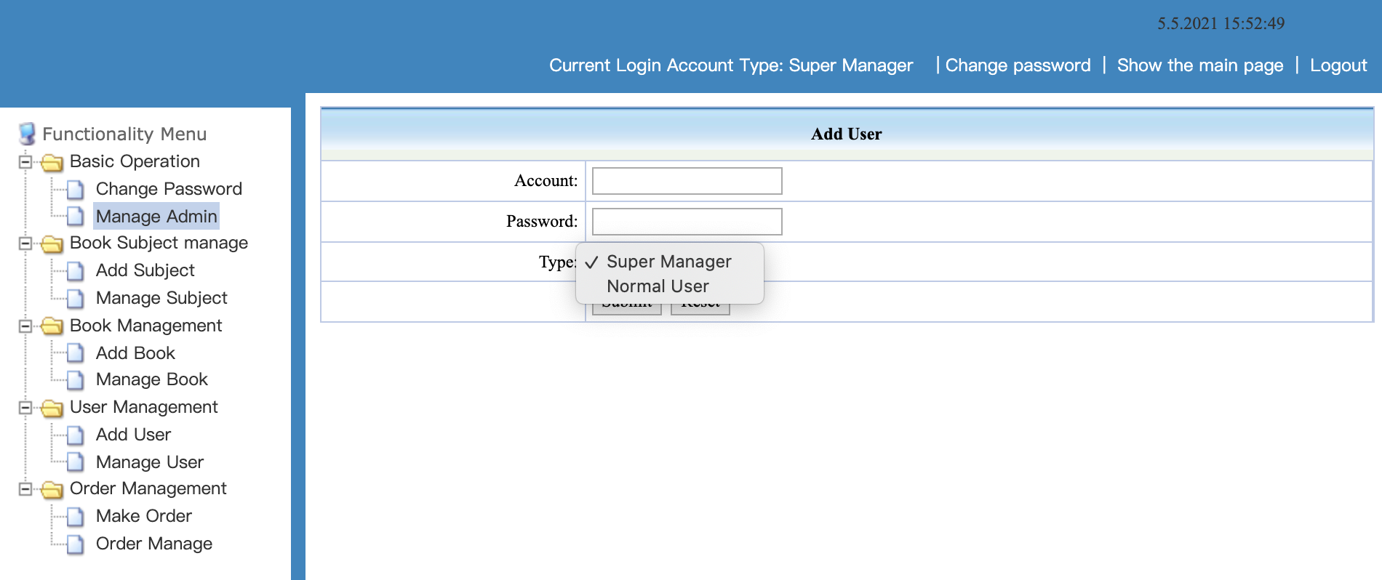
Part of screenshots of functionalities
Order Manage
Log out functionality by pressing the right top button
Normal Customer View – only three sections available
Manager can add another customer or a manager

Slide 11
Functionalities Implemented - I
Log in, assigned default account is admin, and the default pw is admin.
If not input the account, alert suggesting to input the username
If not input the pw, alert suggesting to input the pw
If account and pw not match, alert wrong account or wrong pw
Change Password
If the user just logged in, the login name and the original pw part are prefilled.
One change button to confirm changes, and one reset button to reset all the changes the user made.
If the user input a wrong original pw, alert wrong pw.
If the user doesn’t input a pw in New password text box, alert new pw cannot be null.
Manage Admin
Normal user cannot see the Admin Management page, but the super manager can see it. It shows all the manager’s account name, their corresponding password, and their corresponding roles.
The super manager can choose to delete one of the records by pressing the delete button.
The super manager can add a new customer or a super manager by pressing the add button, input a new account and pw, and select a role.

Slide 12
Functionalities Implemented - II
Book Subject Management.
Only manager can see this section.
Add subject
Manager can input a new classification of a book such as fiction or textbooks.
Manager can also input some introduction from the text box and press submit. Then the database table will store the new added classification with a short introduction.
The manager can also click the reset button to reset all the changes he made.
Manage subject
The manager can look at the subject table with its name along with a short introduction.
The manager can click the delete button to delete a classification from the database.

Slide 13
Functionalities Implemented - III
Book Management
Only manager can see this section
Add book
The manager can input all the necessary entries to add a new book.
If the manager click the reset button, reset all the entries. Click the submit button, insert to the database.
Manage Book
The manager can see a table which shows all the books existed in the database.
In the right part of the table, the manager can click the delete button to delete one book record, or click the change stock button to change its stock.
In down left part of this page, there is a add button and it can redirect the manager to the add book page.
In the down middle and the down right part of this page, the manager can click the next button to go to the next page, or click on the back button to go back the previous page, or click the Front page button to go to the first page, or lick the last button to go to the last page, or input a number and click the page transfer and go to the specific page the manager wants to go.
In this part, manager can also see how many records are there in total, and which page the manager are currently located at.

Slide 14
Functionalities Implemented - IV
User Management
Both the normal customer or the super manager can see this section.
Add User
The users can input all the information there. After the user inputs a login name and a corresponding pw, some parts of the records will store in the admin table and another part of the records will store in the customer table.
The new added customer will be given a normal user role by default. (Only the manager can assign a super manager role in Manage Admin section.)
Manage User
The users can view all the other users’ information from this page.
This page will show all the things about a user instead of its password.
The users can delete one of the user from the table.
There is also a add user button, similar to the previous one, can redirect the user to the add user page.
There is also some buttons and texts redirect to other page and shows the current page information.

Slide 15
Functionalities Implemented - V
Order Management
Both the normal user and the super manager can access this functionality.
Make Order
The user can input corresponding information to make an order.
The user can click the choose button and get redirected to another page to choose which user to choose. Click the right part operation circle, and then click confirm button in down left side. After confirming, the user can see the corresponding name and the user’s user id.
The user can then click the select button and get redirected to another page to choose which book to read. After clicking the circle on the right and pressing confirm button, the user can see the book name and its book id shows up on the table.
Then the user can input a quantity and an order time. There are also one confirm button and a reset button.
Order Manage.
The user can view who ordered which book, how many at which date this order is being made.
The user can also delete records by pressing the delete button.
One add button to redirect to make order page and some text showing the current page.

Slide 16
Functionalities Implemented - VI
In top right, there is a clock showing the current date and a current time.
On the down side, one side shows the Current Login Account Type, and one side shows the change password functionality, one side can hide the left main page or unfold it, and the last side performs a logout functionality.
Hiding the main page is useful when the user wants to see more information on the tables such as staying on order manage section for a while to find a specific order record.

Slide 17
Functionalities partially Implemented
Backend code for the comment_servlet.java and TComment.java. No frontend page for comment functionalities yet. Already have the database table designed.
Two front page designs of the search functionality and one showing statistics front page design of a particular book or a customer.

Slide 18
Thanks for reading
Best regards,
Jialong

